Slide 1
NCRB 2017-2021 Police Disposal of Crime Cases
Exploratory Data Analysis of IPC Crime Disposal in India (NCRB 2017-2021) An analytical study of police investigation outcomes for IPC crimes across India

Slide 2
Dataset Introduction
Source: data.gov.in
Year: The data spans multiple years, showing data from at least 2017 to 2021.
Dataset: This dataset details the state-level disposal of various IPC (Indian Penal Code) crimes by police. It provides granular information on how cases are handled after being reported.
Objective: The primary goal of this analysis is to understand the journey of a reported crime. This includes analyzing how many cases are charge-sheeted, closed by the police, or remain pending at the end of the year. This helps to shed light on the efficiency and outcomes of police investigations for different types of crimes.

Slide 3
Dataset Overview
Attribute | Description
Crime Head | Specific IPC section/group (e.g., Murder, Rape, Theft).
Cases Reported | Fresh cases registered in the given year.
Cases Pending (Previous) | Cases carried forward from the previous year.
Cases Reopened | Cases re-opened for investigation.
Total Cases for Investigation | Sum of reported + reopened + pending cases.

Slide 4
Cases Withdrawn | Cases withdrawn from investigation.
Cases Transferred | Cases moved to other jurisdictions.
Cases Not Investigated | FIRs not investigated further.
Final Report (FR) | Cases closed without charges (subdivided into false, mistake, insufficient evidence, non-cognizable, abated).
Chargesheeted (Prev/Current) | Cases sent to court for trial, from previous and current year.
Chargesheeted Total | Total cases chargesheeted (prev + current).
Total Disposed | Final Report + Chargesheeted.
Cases Quashed | Cases dismissed by court.
Cases Stayed | Cases put on hold due to legal/administrative reasons.
Cases Pending Year-End | Cases still under investigation at year-end.
Charge-Sheeting Rate | % of disposed cases that resulted in chargesheeting.
Pendency Rate | % of total cases that remained unresolved.

Slide 5
Summary
Years covered: 2017 – 2021
Number of observations: about 118–119 each year(excluding totals)
Variables tracked: 25 variables (e.g., cases_reported, chargesheeting_rate, pendency_rate).
Notable trends: Cases reported: rose from 31k mean in 2017 → 42k mean in 2020.
Chargesheeting rate: remained relatively high (≈73–76% median across years).
Pendency rate: climbed from median 34% (2017) to 41% (2020).

Slide 6
Year | Obs. | Mean Cases Reported | Median Chargesheeting Rate | Median Pendency Rate
2017 | 119 | 31,361 | 84.8% | 34.6%
2018 | 119 | 32,328 | 80.9% | 34.6%
2019 | 118 | 33,541 | 81.7% | 36.9%
2020 | 118 | 42,302 | 82.9% | 41.5%
2021 | 118 | 37,553 | 83.0% | 38.5%

Slide 7
Trends and Visualizations

Slide 8
Year wise plots - top 10 crimes each year

Slide 9
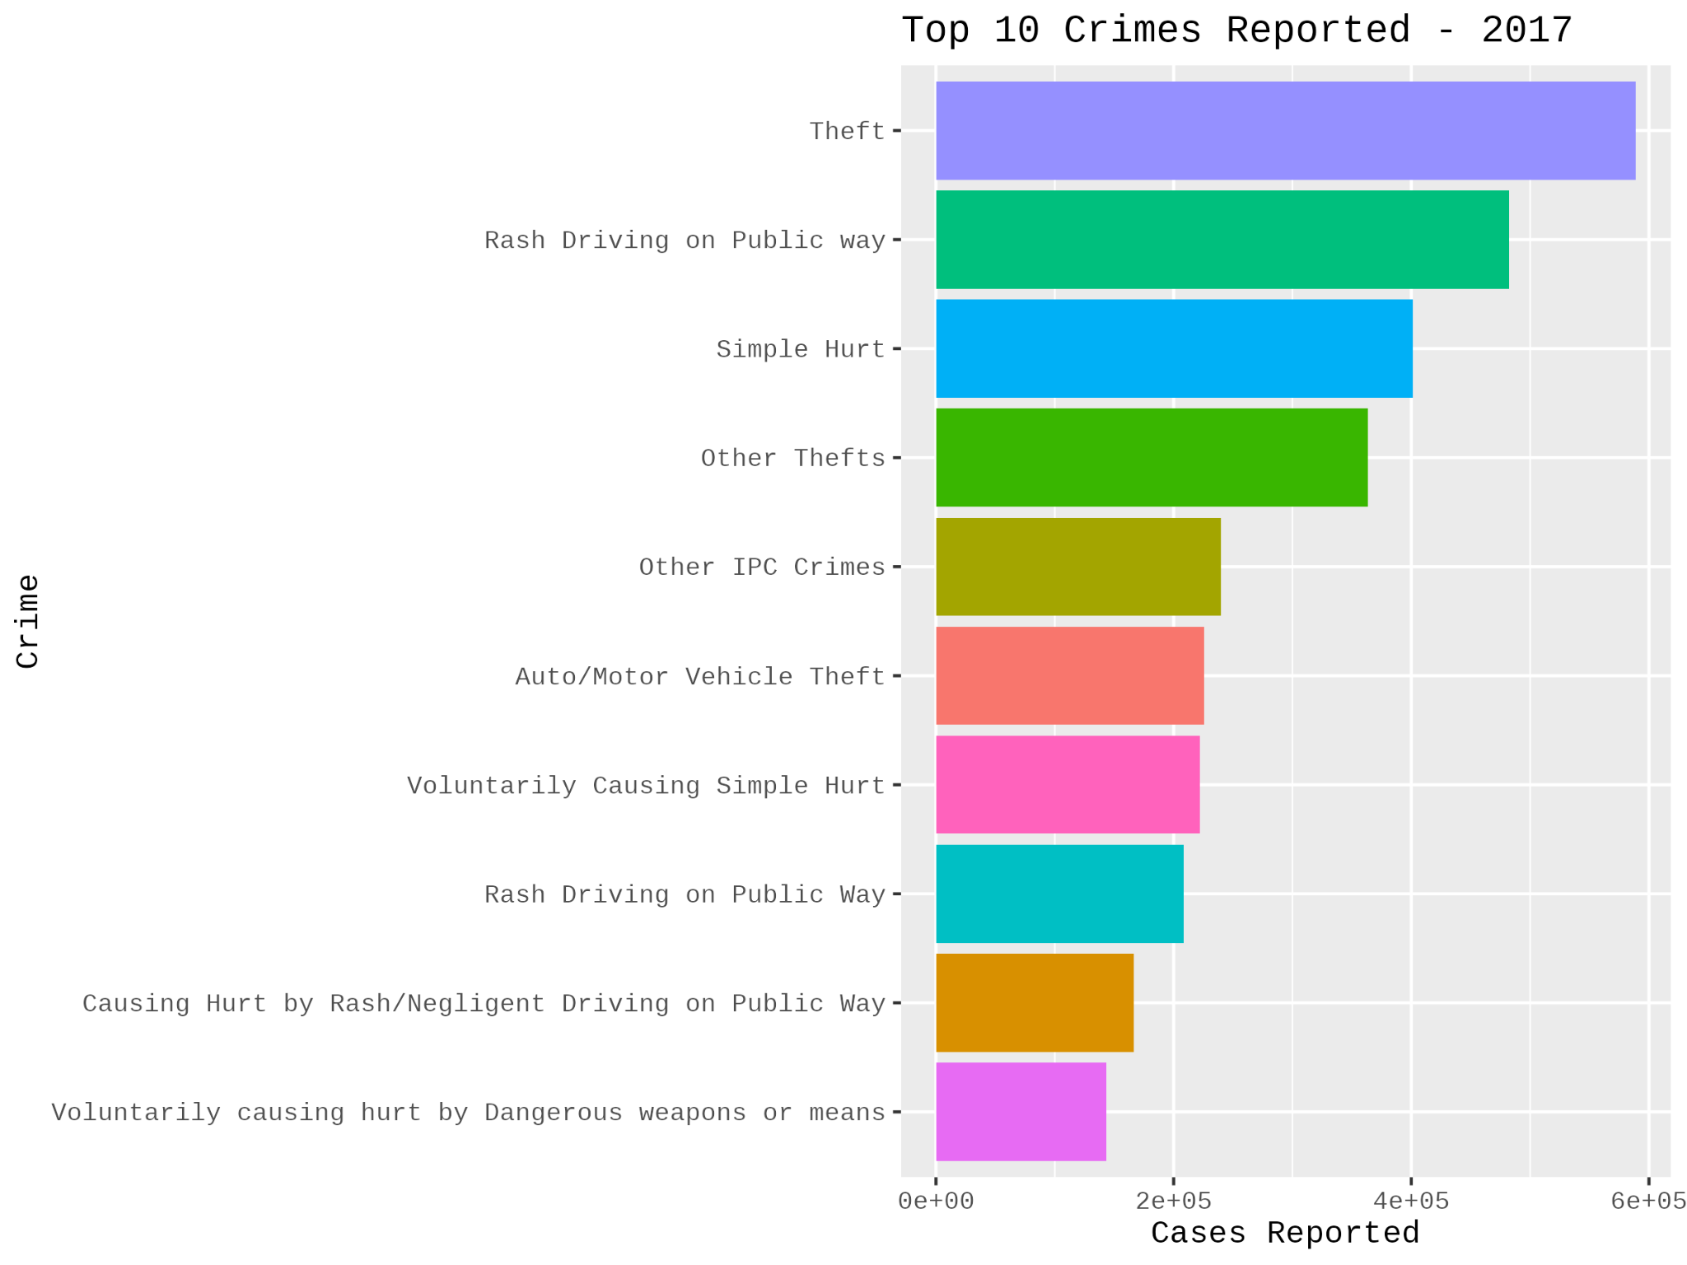
1)Top 10 Crimes reported in 2017

Slide 10
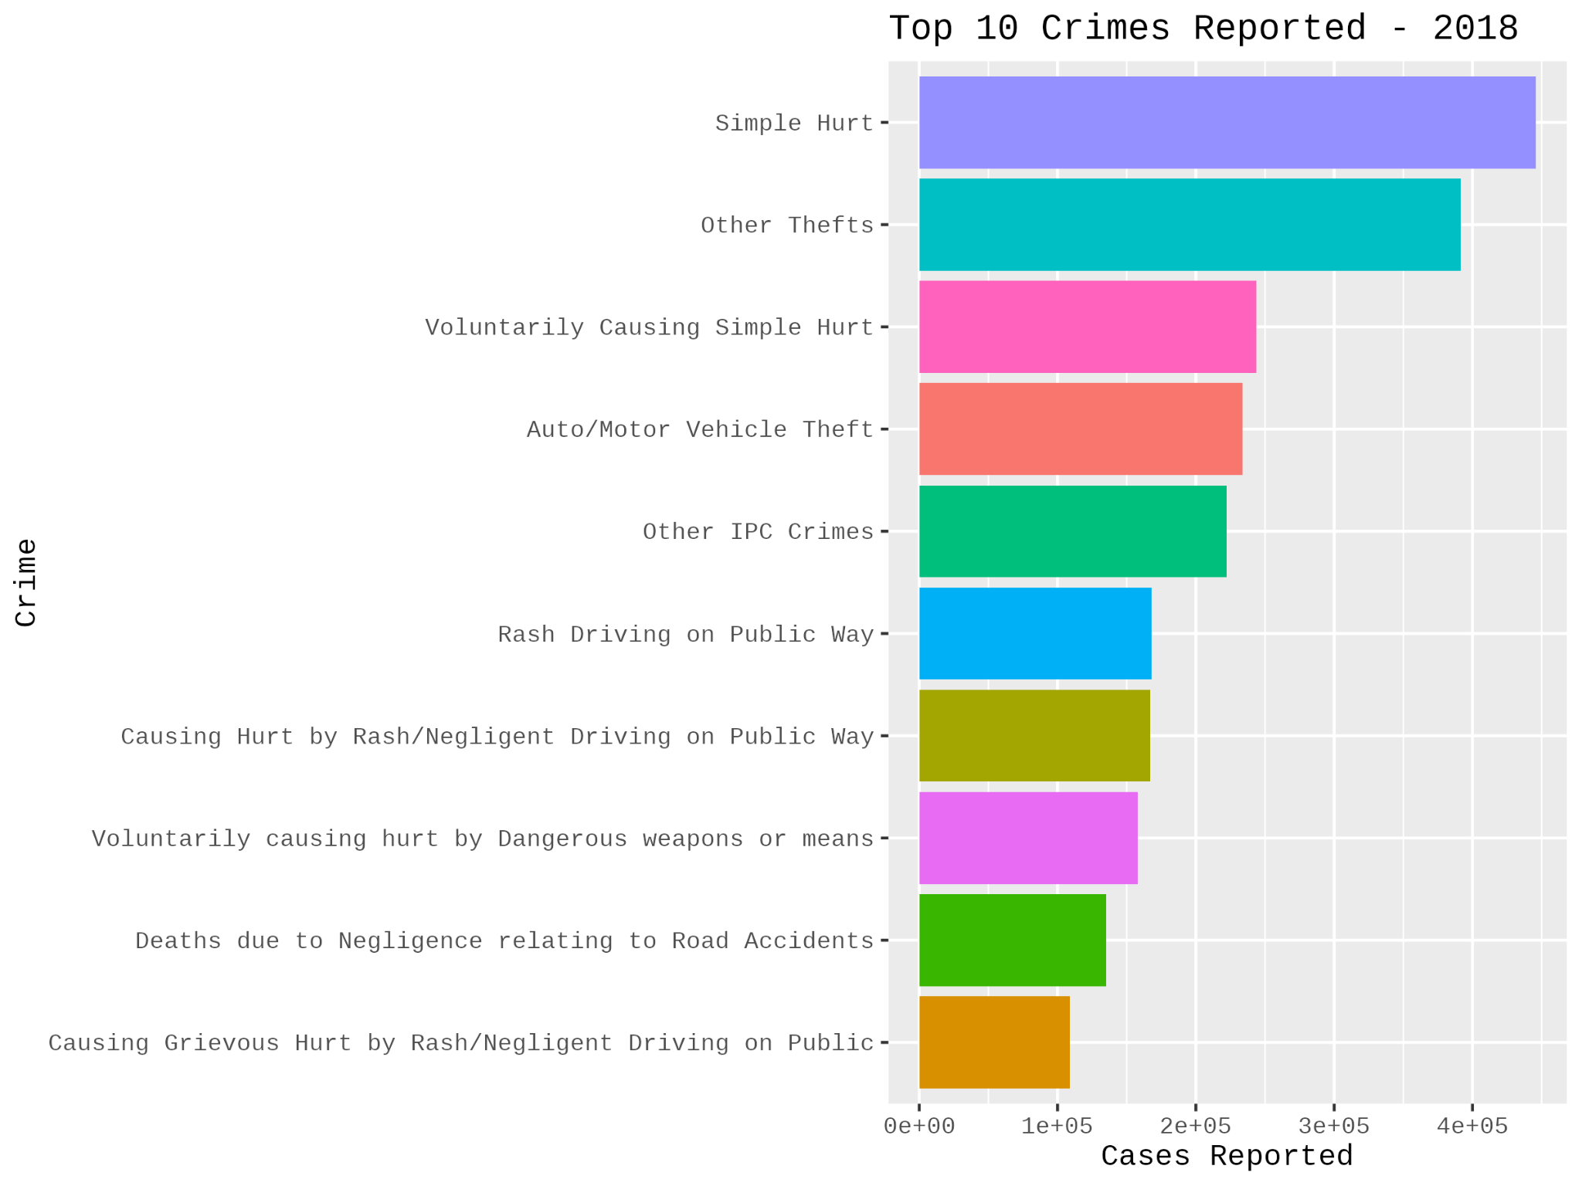
2)Top 10 Crimes reported in 2018

Slide 11
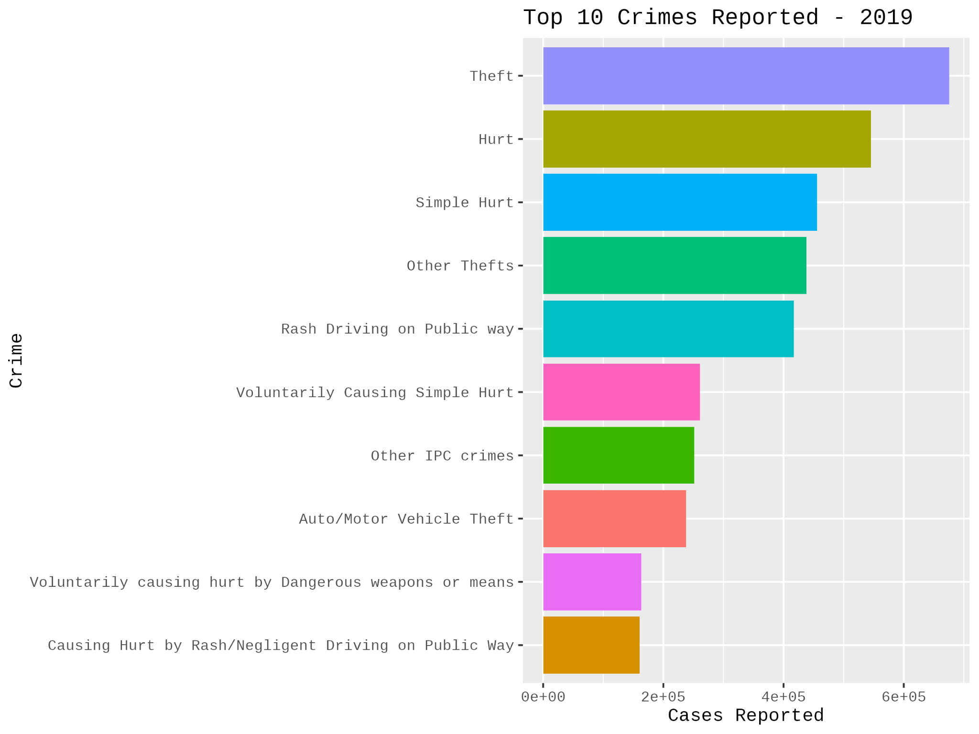
3)Top 10 Crimes reported in 2019

Slide 12
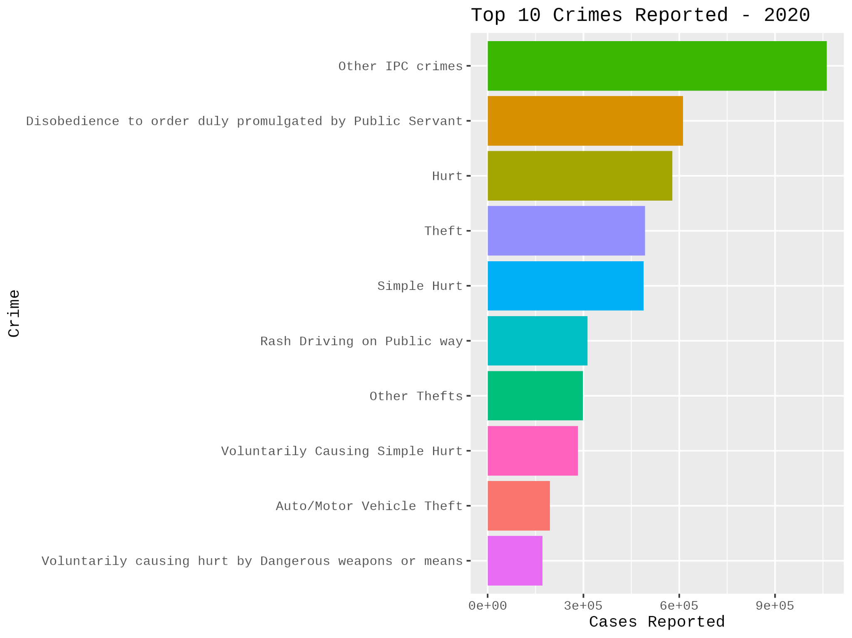
4)Top 10 Crimes reported in 2020

Slide 13
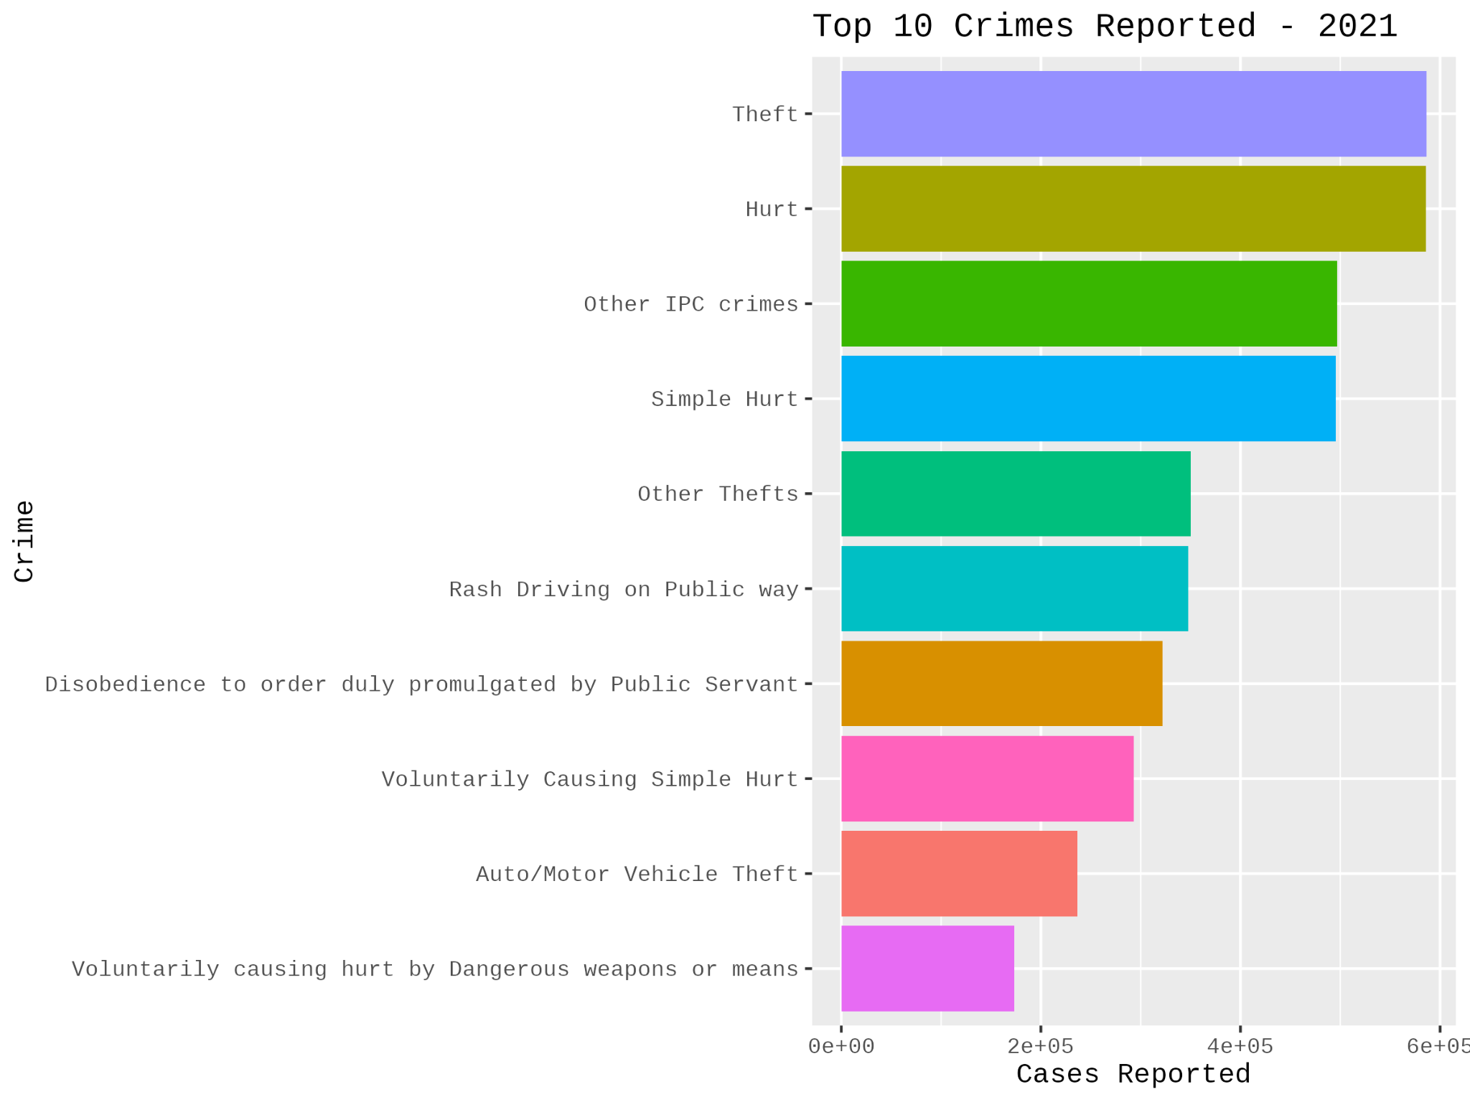
5)Top 10 Crimes reported in 2021

Slide 14
Top 10 Crimes Reported by Year
2017: Theft was the most reported crime, followed by Rash Driving and Simple Hurt.
2018: Simple Hurt topped the list, with Other Thefts and Voluntarily Causing Simple Hurt following. This year's list also included "Causing Hurt by Rash/Negligent Driving on Public Way" and "Deaths due to Negligence relating to Road Accidents."
2019: Theft returned to the top spot, followed by Hurt and Simple Hurt.
2020: Other IPC Crimes became the most reported, followed by Disobedience to order duly promulgated by Public Servant. This is a direct reflection of public health orders and lockdown violations during the pandemic.
2021: Theft was once again the most reported crime, followed closely by Hurt. "Other IPC crimes" and "Simple Hurt" were also very high.

Slide 15
Total cases reported, Average chargesheeting rate, Average pendency rate from years 2017-2021

Slide 16
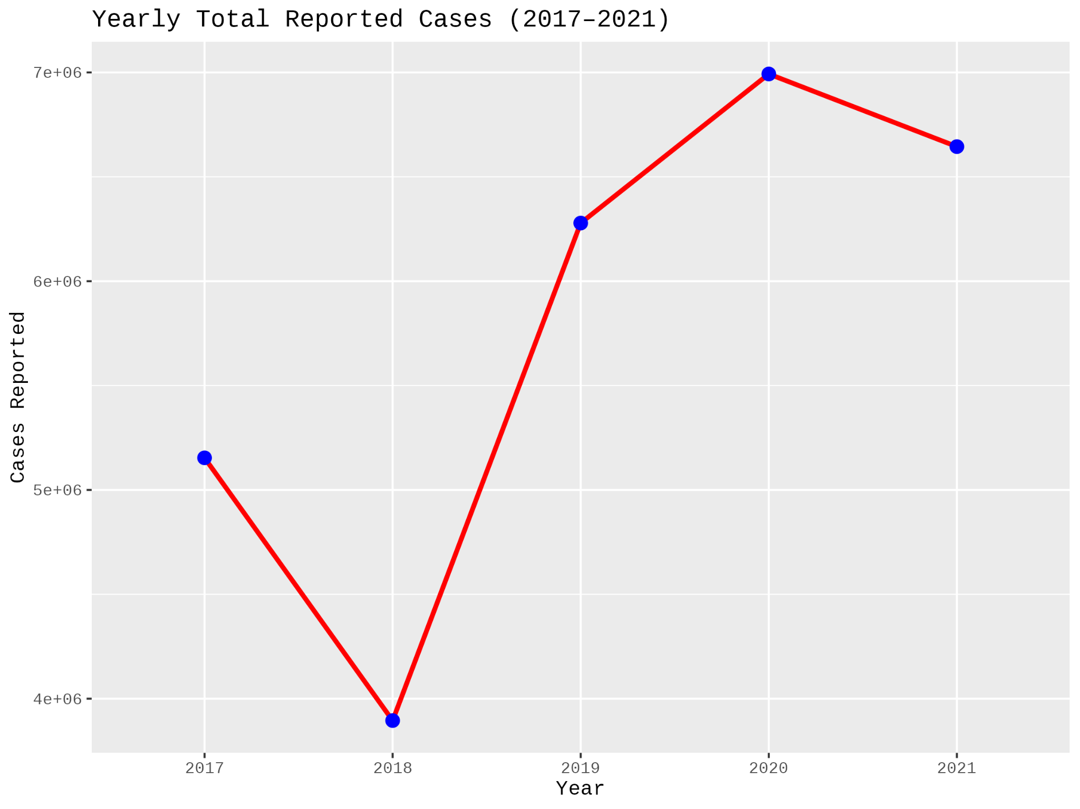
1.Total cases reported over the years

Slide 17
Total Reported Crime Cases (2017–2021)
📈 Trend Summary:
🔻 2017 → 2018: Significant decline (~24%) in reported cases.
🔺 2018 → 2019: Sharp increase (~62%) — possibly due to increased reporting or a real rise in crime.
🔺 2019 → 2020: Continued growth, reaching the highest number of reported cases.
🔻 2020 → 2021: Slight decrease, indicating possible stabilization post-peak.

Slide 18
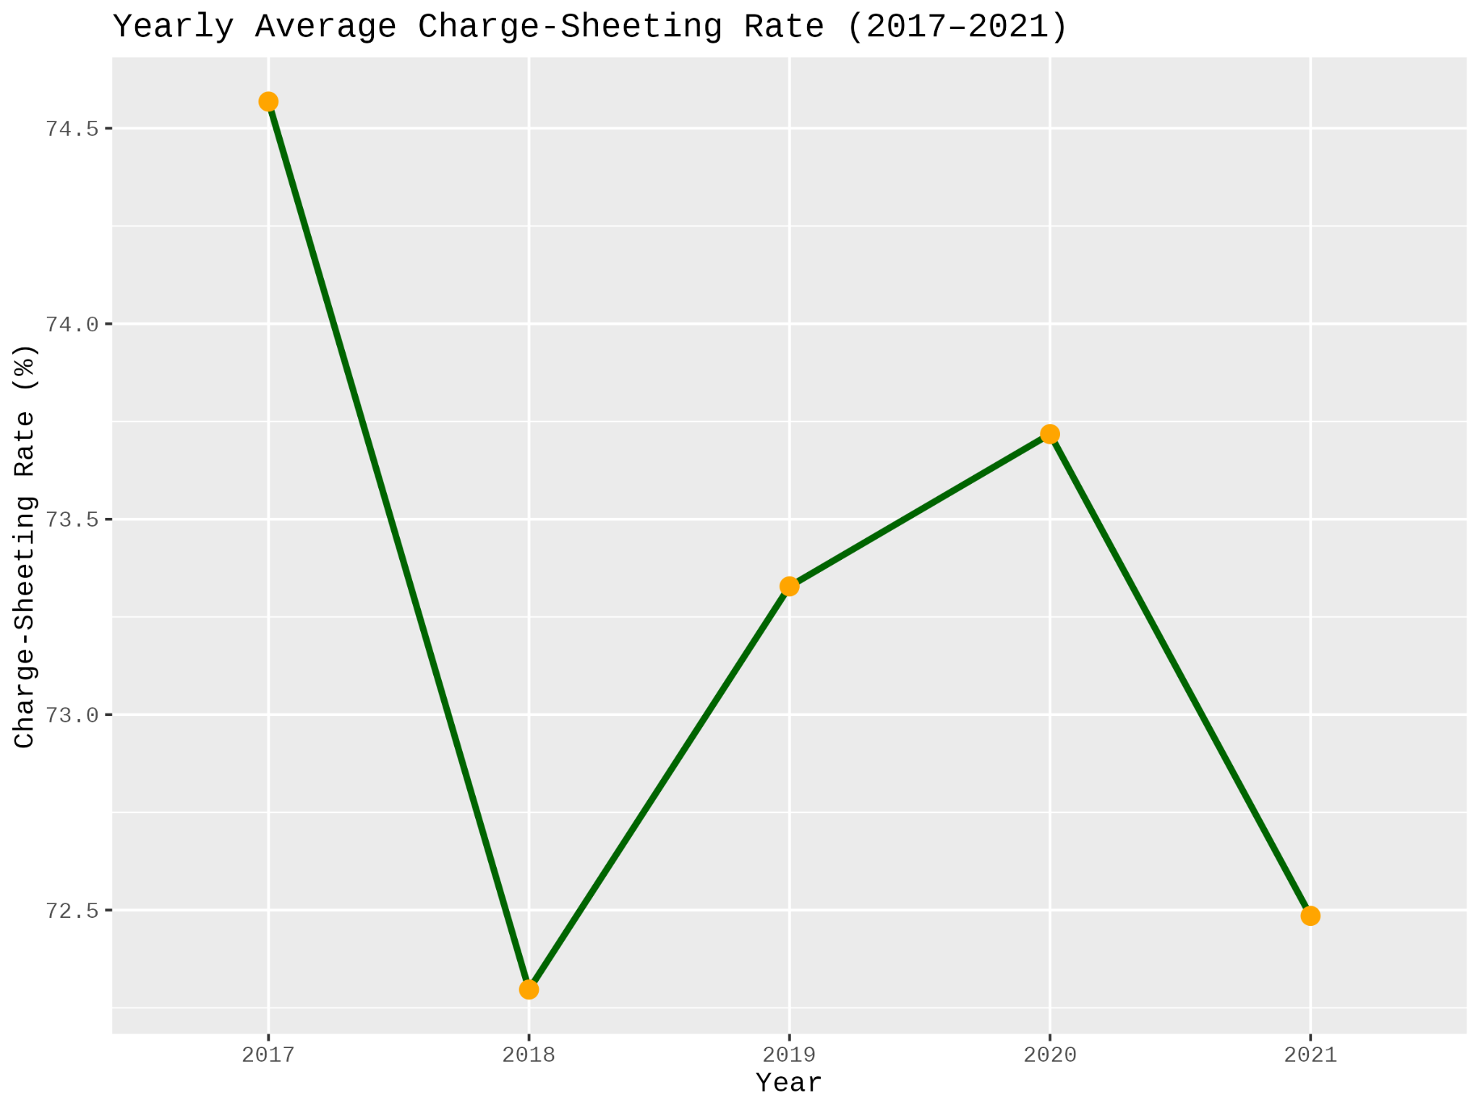
2.Average chargesheeting rate

Slide 19
Average Charge-Sheeting Rate (2017–2021)
This graph illustrates the average charge-sheeting rate (%) from 2017 to 2021.
Charge-sheeting rate indicates the percentage of cases in which police filed charge sheets (formal accusations) after investigation.
Summary:
2017 → 2018: 🔻 Drop of ~2.3%, possibly indicating delays or bottlenecks in investigation.
2018 → 2020: 🔺 Gradual improvement, reaching 73.7% in 2020.
2020 → 2021: 🔻 Decline again, falling to 72.5%.
🧠 Interpretation:
The charge-sheeting rate fluctuated between 72% and 75%, reflecting:
Variability in police efficiency or legal system capacity.
Possible impact of increased cases in 2019–2020 on investigative workload.
The COVID-19 pandemic in 2020 may have initially caused delays but also may have prompted process optimizations.

Slide 20
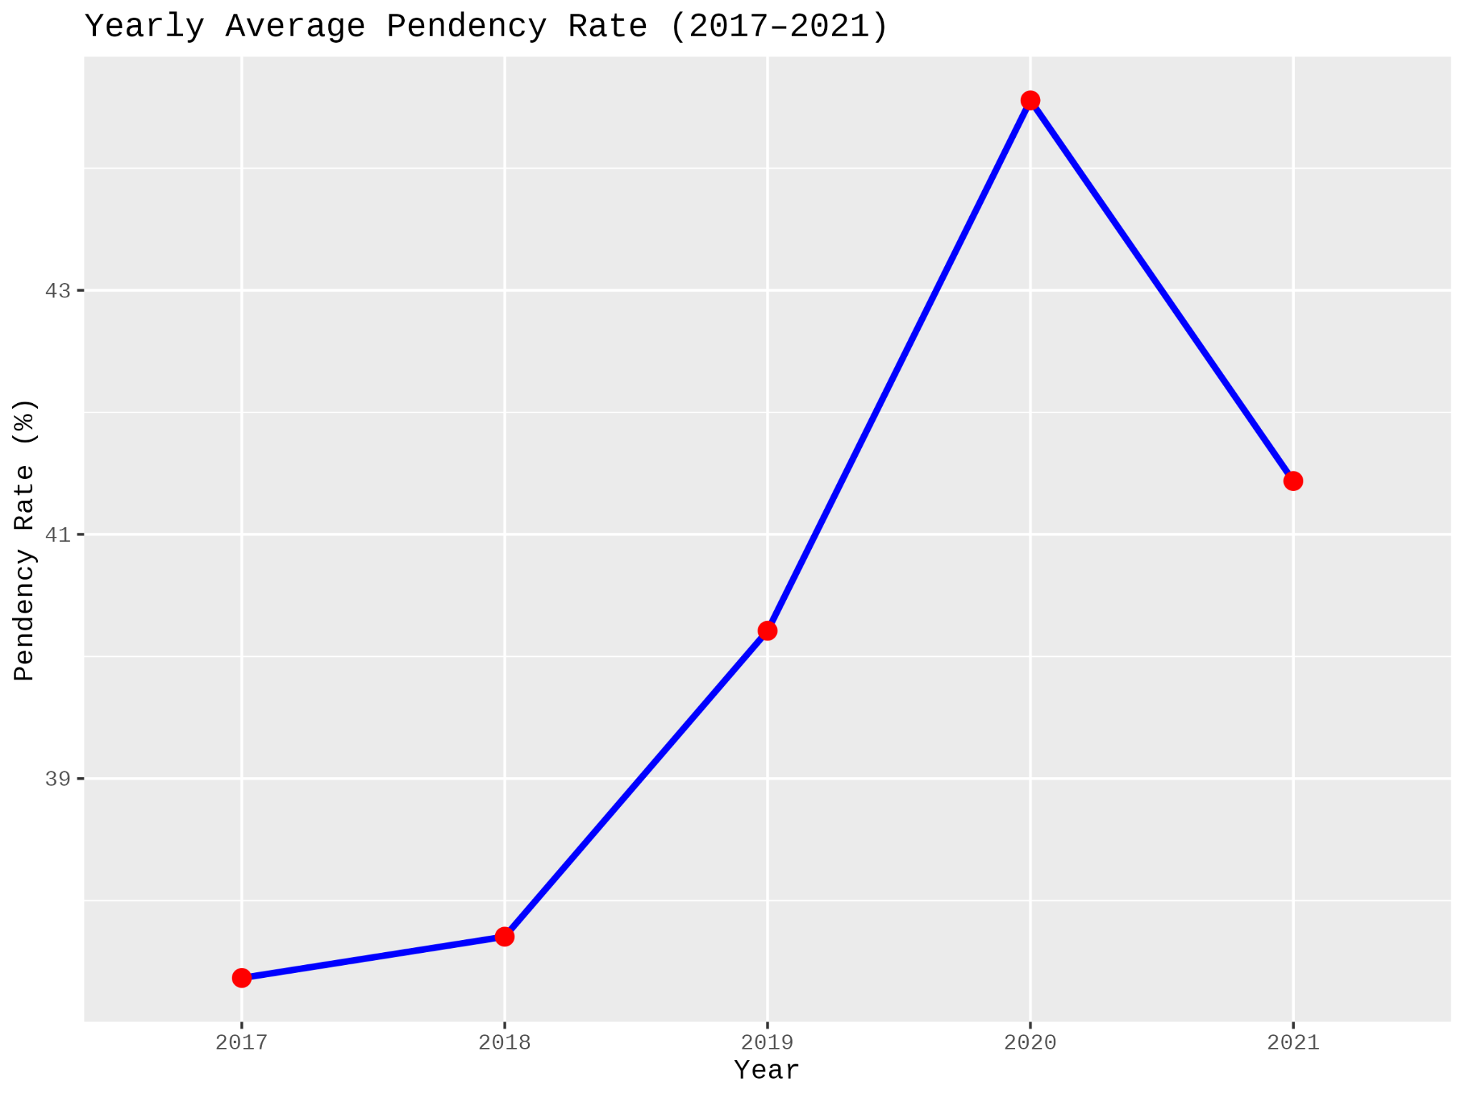
3.Average pendency rate

Slide 21
Average Pendency Rate (2017–2021)
The graph illustrates the average pendency rate (%) of criminal cases over a five-year period from 2017 to 2021.
Pendency rate refers to the percentage of cases still pending investigation at the end of each year.
A higher rate reflects delays or backlog in resolving cases.
Trend Analysis:
🔼 2017–2018: Minor increase; system relatively stable.
🔼 2018–2020: Sharp rise of over 7% in two years, peaking at 44.8%.
Indicates a significant backlog likely due to:
Spike in reported cases (see earlier slide)
Disruptions during the COVID-19 pandemic
🔽 2020–2021: Slight reduction (~3.6%) — possibly due to improved clearance efforts or policy changes.
Interpretation & Implications:
The rising pendency trend reflects growing pressure on the investigative and judicial systems.
The 2020 peak aligns with the surge in total reported cases and pandemic disruptions.
The decline in 2021 is a positive signal, suggesting steps may have been taken to clear backlog — but the rate remains high.

Slide 22
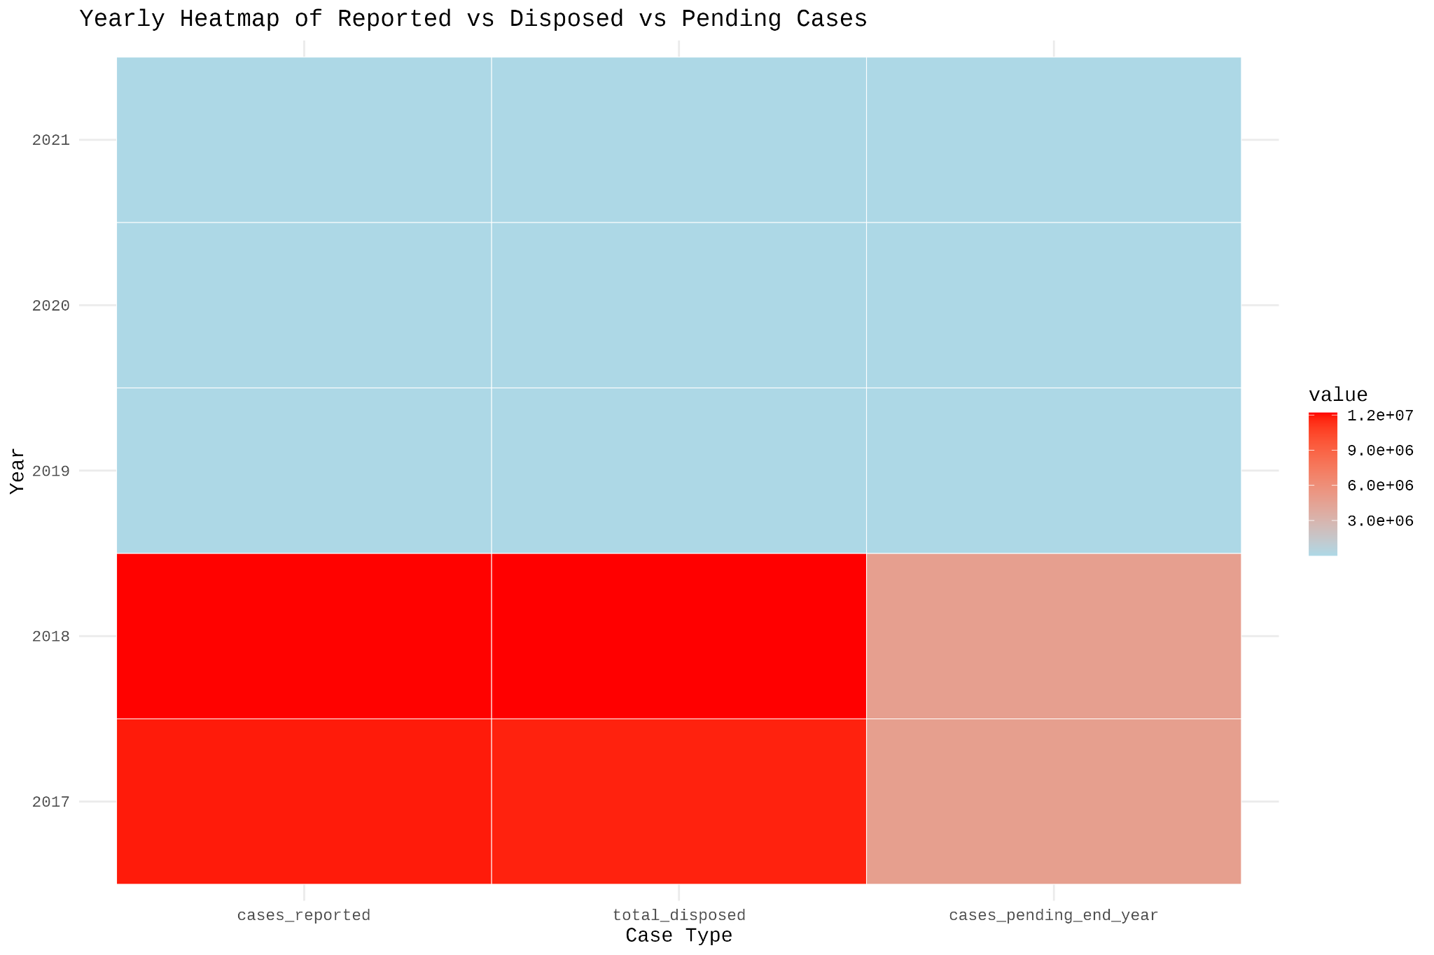
Yearly heatmap of reported vs disposed vs pending

Slide 23
Yearly heatmap of reported vs disposed vs pending
Color Intensity (Heatmap shading):
Red = Higher values
Blue = Lower values
The color scale on the right shows values from approximately 3 million to 12 million.
Key Observations:
2017–2018 had the highest number of cases reported, disposed, and pending, as indicated by the red color.
These years saw the most judicial activity.
Despite high disposal rates, the pending cases remained high, indicating possible backlog accumulation.
2019–2021 show a sharp drop across all three categories (blue color).
Could be due to external factors such as policy changes, administrative slowdowns, or COVID-19 pandemic (especially for 2020–2021).
All categories dropped together, suggesting fewer reported cases and less judicial throughput overall.

Slide 24
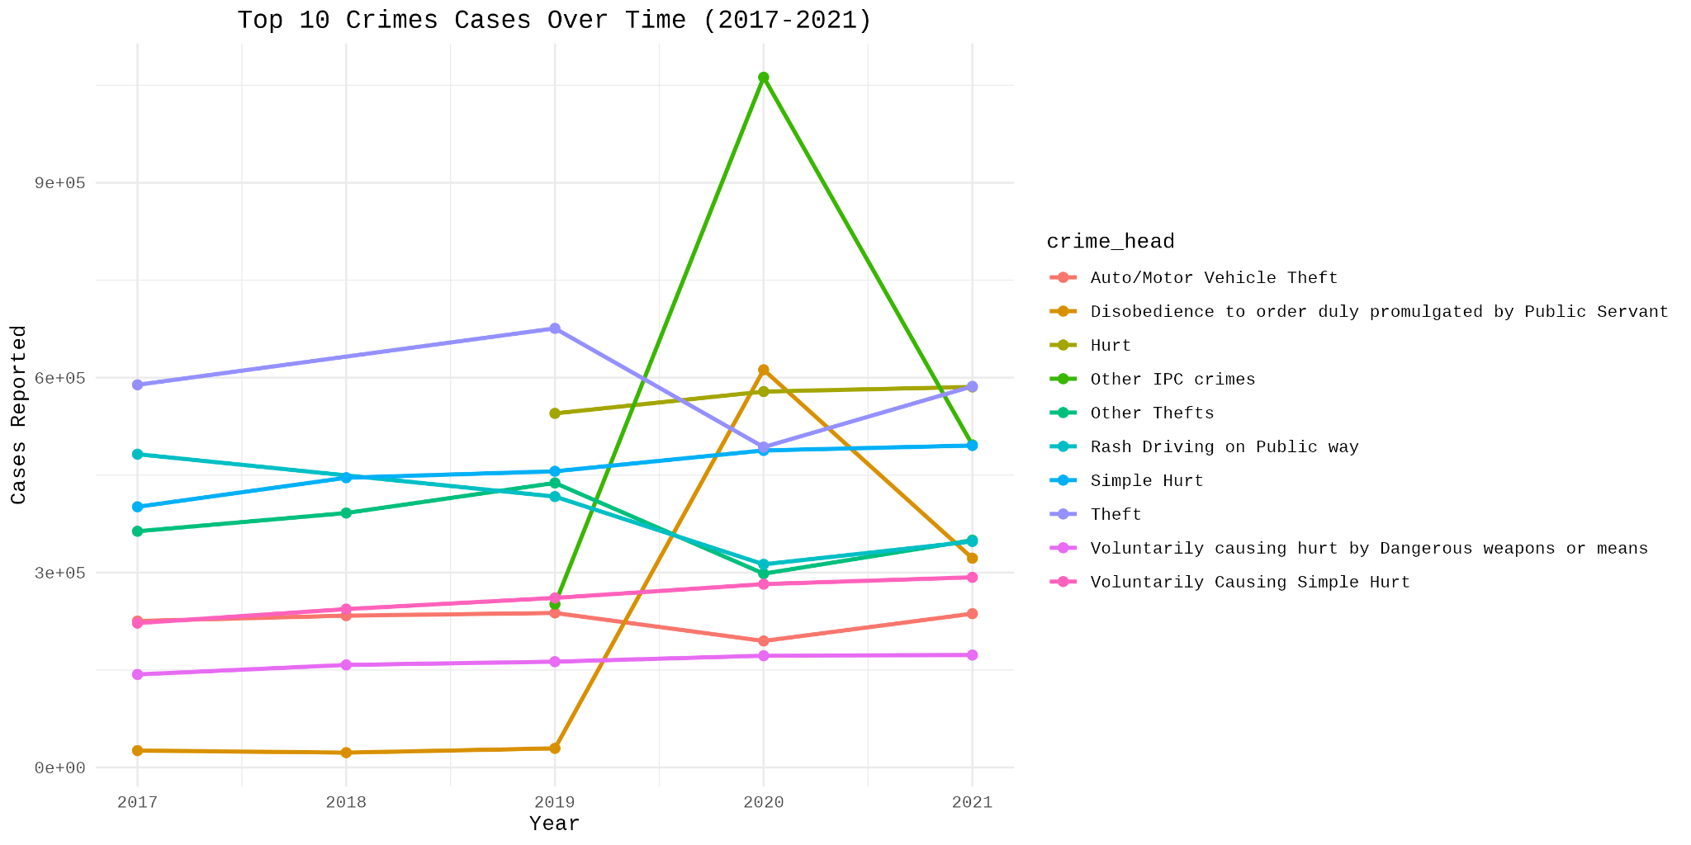
Top 10 crimes over 2017-2021

Slide 25
Top 10 Crimes Cases Over Time (2017-2021)
The plot shows the case numbers for the top 10 crimes fluctuating over the years.
Notably, "Other IPC crimes" and "Disobedience to order duly promulgated by Public Servant" spiked dramatically in 2020, reaching their highest points in the five-year period.
In contrast, Theft showed a relatively stable trend, consistently remaining a top-reported crime with high case numbers throughout the period.

Slide 26
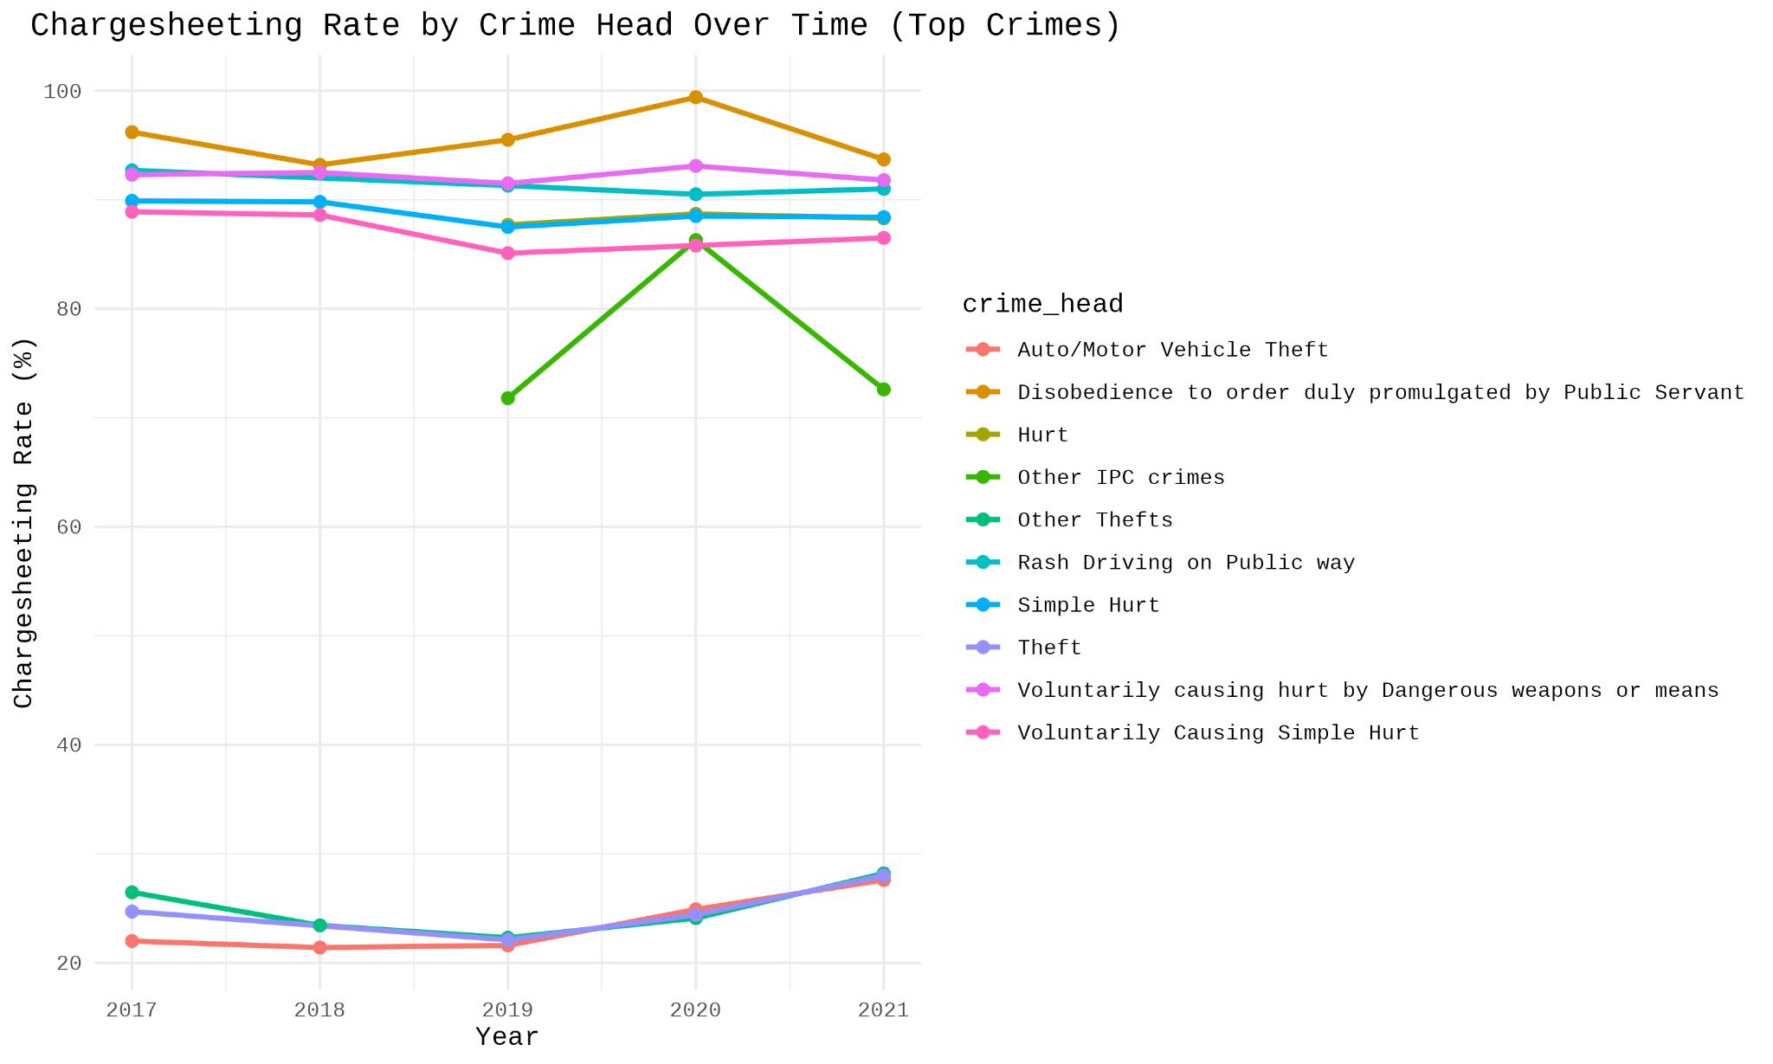
Chargesheeting rate for top 10 crimes over 2017-2021

Slide 27
Chargesheeting rate for top 10 crimes over 2017-2021
Chargesheeting Rate by Crime Head Over Time
The "Chargesheeting Rate" plot shows the percentage of cases where a charge sheet was filed, by crime type, from 2017 to 2021.
High Chargesheeting Rate: The crimes with consistently high chargesheeting rates (above 85%) throughout the period are Hurt, Disobedience to order duly promulgated by Public Servant, Rash Driving on Public Way, and Simple Hurt. This indicates that a high proportion of these cases result in a formal charge sheet being filed.
Volatile Rate for 'Other IPC crimes': The chargesheeting rate for Other IPC crimes shows a significant fluctuation. It was around 70% in 2019, spiked to nearly 90% in 2020, and then dropped back down to roughly 70% in 2021. This volatility suggests inconsistency in the investigation and filing process for this category.
Low Chargesheeting Rate: Crimes like Auto/Motor Vehicle Theft and Other Thefts consistently have very low chargesheeting rates, hovering around 20-25%. This suggests that a majority of these theft cases remain unsolved or do not lead to a charge sheet being filed.
Stable Rates: Most other crimes, particularly those with high rates, show a stable trend with minor fluctuations.

Slide 28
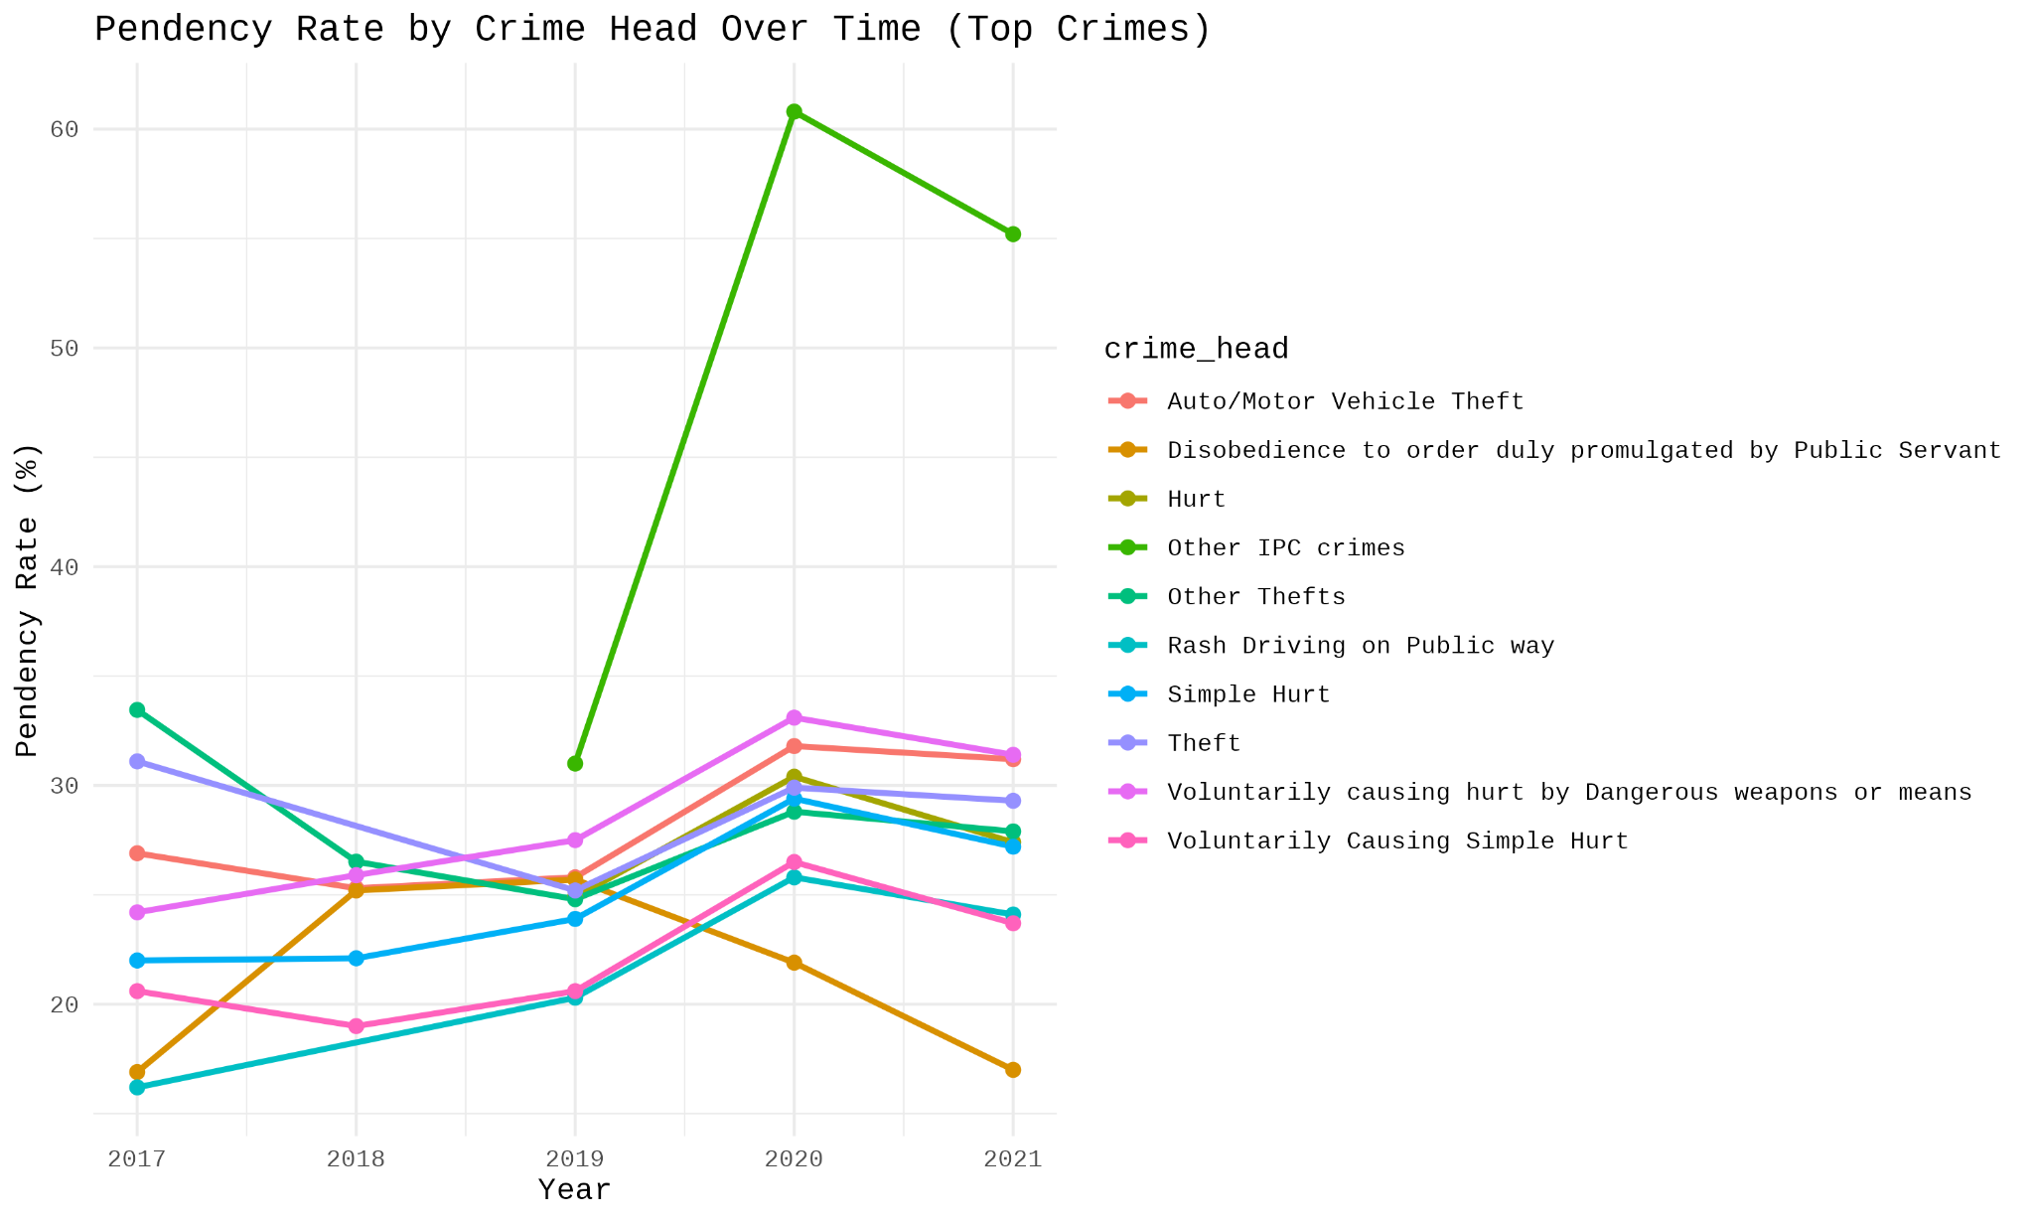
Pendency rate for top 10 crimes over 2017-2021

Slide 29
Pendency rate for top 10 crimes over 2017-2021
Pendency Rate by Crime Head Over Time
The "Pendency Rate" plot shows the percentage of cases that are pending investigation at the end of the year.
Low Pendency for High Chargesheeting Crimes: As expected, the crimes with high chargesheeting rates (Hurt, Disobedience to order duly promulgated by Public Servant, Rash Driving on Public Way, and Simple Hurt) also have relatively low and stable pendency rates, generally between 20% and 30%. This indicates that these cases are typically resolved in a timely manner, with fewer remaining pending.
High Pendency for 'Other IPC crimes': The pendency rate for Other IPC crimes mirrors the volatility seen in its chargesheeting rate. It shows a dramatic surge in 2020, reaching over 60%, before decreasing in 2021. This corresponds to the year its chargesheeting rate peaked, suggesting a backlog of cases despite more charge sheets being filed. The overall high pendency for this category indicates that many of these cases are not being resolved quickly.

Slide 30
Stable Pendency for Low Chargesheeting Crimes: Interestingly, the crimes with low chargesheeting rates (Auto/Motor Vehicle Theft and Other Thefts) maintain a stable and relatively low pendency rate (around 20-30%), similar to the high chargesheeting crimes. This suggests that while a small percentage of these cases lead to a charge sheet, the remaining cases are not lingering indefinitely as pending investigations. They are likely being closed out for other reasons, such as a lack of evidence or the inability to identify a suspect.
Correlation: There's an inverse relationship between the chargesheeting rate and the pendency rate for most crimes, but it's not a perfect inverse correlation. For instance, the dramatic increase in the chargesheeting rate for "Other TPC crimes" in 2020 seems to correlate with a very large spike in its pendency rate, which is an unusual pattern and may indicate an issue with case management or reporting for that year.

